Slide 1
SQL
Joins - Exercises

Slide 2
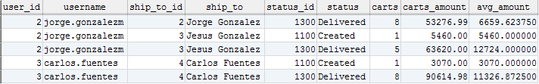
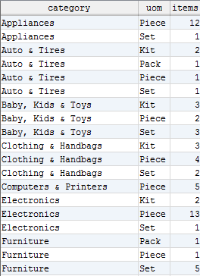
Joins - Exercises
1. Get the number of carts by ShipTo and Status, from Carts “CREATED” and “DELIVERED” and which the average of cart_amount on each group is between $ 3,000 and $ 15,000.
Include the relevant description for ShipTo and Status.
2. Get the number of Items by Category and UnitOfMeasure.
Sort the result by Category and then by UOM.

Slide 3
Jorge Luis Gonzalez
jorge.gonzalezm@softtek.com
Instructor

